Slide 1
Cookbook Network
Anais Hernandez
Aqib Shah
Erico Oyarzun

Slide 2
Overview
Virtual Recipe Book
Each recipe will have short tags
3 Users: Guest, Registered, and Administrator

Slide 3
Functional Requirements
All users can search for and access public recipes based on title, ingredients and tags.
Guest users can register and create an account.
Registered users can create, delete, and edit their recipes & cookbooks.
Registered users can set their cookbook & recipe to public, registered, friendly, or private.
Administrators can delete recipes, remove irrelevant tags, and delete users.

Slide 4
Use Case 1: Create Recipe
Trigger:
User selects “Add New Recipe” link
Normal Course:
User selects link to add new recipe
System displays new recipe page
User enters recipe information (e.g., title, ingredients, directions, etc.) and submits

Slide 5
Use Case 1: Create Recipe (cont.)
System displays the recipe
Exceptions:
User Cancels
System displays confirmation page
User confirms
System displays account page

Slide 6
Use Case 1: Create Recipe (cont.)
Title Left Blank
System displays message that recipe must have title
Return to Normal Course 1.2
Ingredients Left Blank
System displays message that recipe must have ingredients
Return to Normal Course 1.2

Slide 7
Use Case 1: Create Recipe (cont.)
Directions Left Blank
System displays message that recipe must have directions
Return to Normal Course 1.2

Slide 8
Use Case 2: Register Account
Trigger:
User selects “Sign Up” link
Normal Course:
User selects sign up link
System displays registration page
User enters email and password and submits
System displays success page

Slide 9
Use Case 2: Register Account (cont.)
Exceptions:
User Enters Email That Is Already In Use
System displays message that the email is already in use
Return to Normal Course 1.2
User Enters Invalid Email
System displays message that the email is invalid
Return to Normal Course 1.2

Slide 10
Use Case 2: Register Account (cont.)
Password Left Blank
System displays message that password cannot be blank
Return to Normal Course 1.2
User Cancels
System displays home page

Slide 11
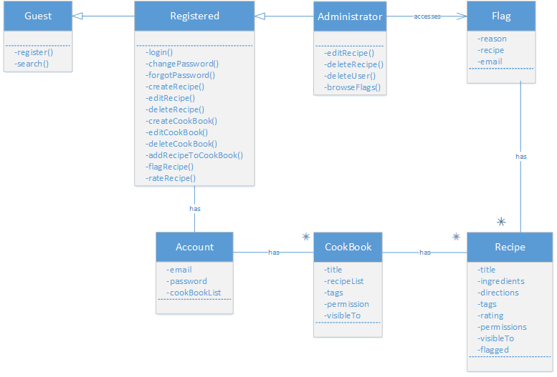
Class Diagram

Slide 12
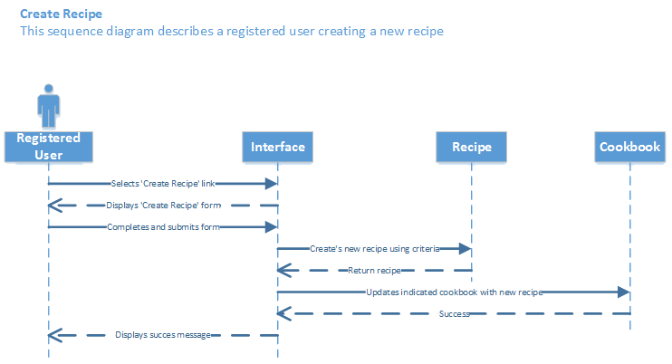
Sequence Diagram: Create Recipe

Slide 13
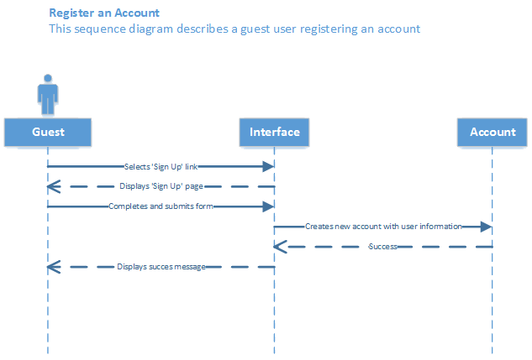
Sequence Diagram: Register Account

